Slide 1
Closy
The Social Network Web Project

Slide 2

Closy
The Social Network Web Project
https://github.com/mithu2649/closy

Slide 3
What is Closy? Give me a gist of it.

Slide 4
What is Closy? Give me a gist of it.
1
A Social Network for everyone
2
A place to share and communicate with friends
3
To let the world know you and your interests
4
Create new friends online

Slide 5
How is Closy better? Why Should I use it?

Slide 6
How is Closy better? Why Should I use it?
1
Completely Open Source
2
Developers can add or remove features
3
It is clean: No advertisements 🙂
4
Minimalistic Design – Less is more

Slide 7
Why was Closy created? What was the objective of creating this project?

Slide 8
Why was Closy created? What was the objective of creating this project?
1
Currently available Social Networks are feature rich but bloated.
2
To create a platform without the marketing thing
3
Open Source. Any one can contribute to the project
4
Can be accessed from Anywhere. Anytime. On any device.

Slide 9
What is Closy Built on? What are the technologies used for the project?

Slide 10



What is Closy Built on? What are the technologies used for the project?
php
MySQL
JavaScript
Fast, flexible and pragmatic,
PHP powers everything from your blog to the most popular websites.
Performant, Reliable, Easy to Use.
MySQL is the world's most popular open source database.
JavaScript is the engine that drives the internet. Virtually every one of your favorite websites uses JavaScript in some way or the other.

Slide 11

What is Closy Built on? What are the technologies used for the project?
php
MySQL
JavaScript
Ajax
And more…
😍
To send and receive data asynchronously from a client or server, it is done behind the scene and you don't need to reload the webpage
Fast, flexible and pragmatic,
PHP powers everything from your blog to the most popular websites.
Performant, Reliable, Easy to Use.
MySQL is the world's most popular open source database.
JavaScript is the engine that drives the internet. Virtually every one of your favorite websites uses JavaScript in some way or the other.
Other technologies will be added as the project grows

Slide 12
What does Closy require? What are the requirements to develop the Website?

Slide 13

What does Closy require? What are the requirements to develop the Website?
First things first, let’s talk about hardware.

Slide 14
What does Closy require? What are the requirements to develop the Website?
Hardware Requirements
1
A decent PC/Laptop with at least 2GB of RAM
2
CPU : not older than 4 years
3
X64 bit systems recommended for softwares used for development
4
A Smartphone for testing responsiveness of the website

Slide 15

What does Closy require? What are the requirements to develop the Website?
What are the softwares required?

Slide 16
What does Closy require? What are the requirements to develop the Website?
Software Requirements
1
Xampp Server – for Locally developing the site
2
Browsers – for running and debugging the project as it is developed
3
Text Editor : VS Code, Sublime, Notepad++ etc.
4
MySQL Workbench: for database management

Slide 17
How is Closy designed to work? How does the data flow in Closy?

Slide 18
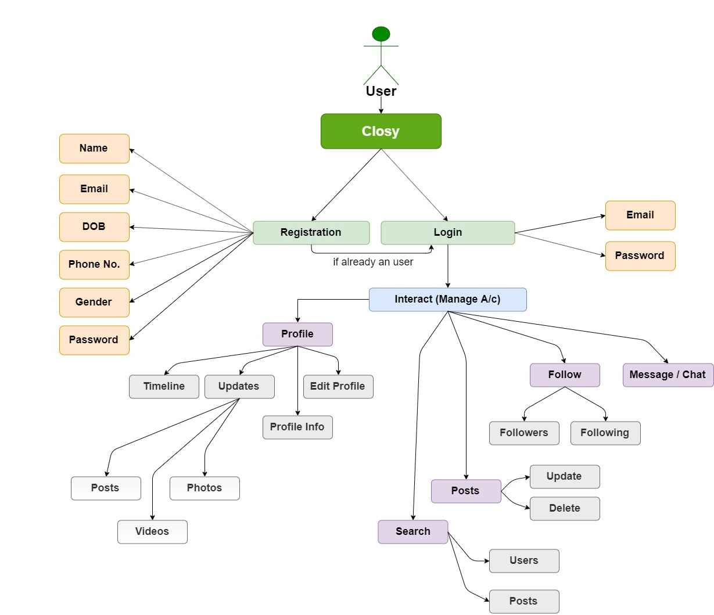
Data Flow Diagram

Slide 19
How do I use Closy? How to get started with Closy and use it?

Slide 20
How do I use Closy? How to get started with Closy and use it?
1
To get started with Closy, go to the closy website (yet to be hosted)
2
Create a new account
3
Login with your mail and password of the created account
4
You can now interact with the interface and figure out things…

Slide 21
OK, So what have you planned? Tell me about the plan and schedule of the development.

Slide 22
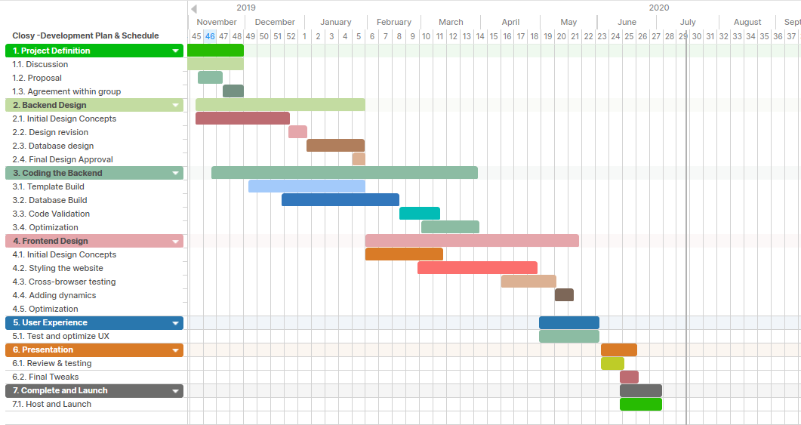

That’s the finishing line
Gantt Chart

Slide 23
And, the database? What are the entities and the relationship between them?

Slide 24
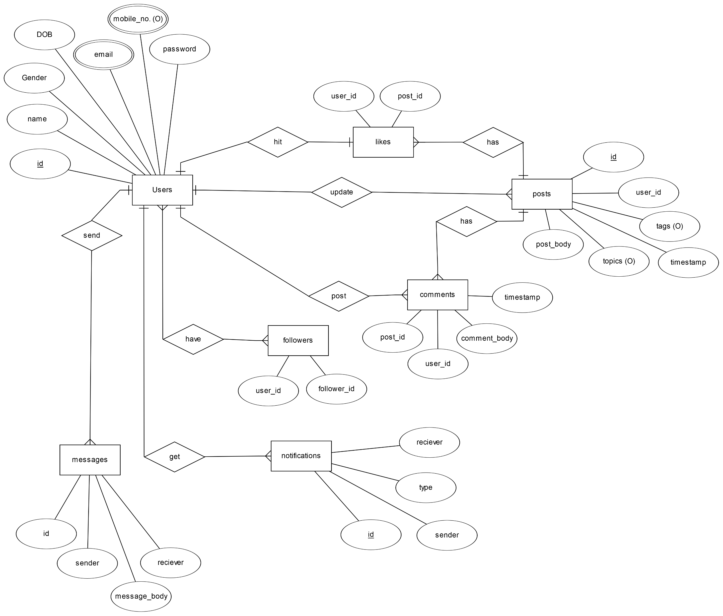
Entity Relationship Diagram

Slide 25
What did we talk about Give me a summary of everything.

Slide 26
What did we talk about Give me a summary of everything.
What Closy is?
The objective of creating it.
Open Sourced under GNU GPL License
Hosted on GitHub
Technology Stack
Requirements – Hardware and Software
Data Flow
How to use? Process to login to the system.
Planning and Scheduling
Database Design
Market Potential
Current status of the project

Slide 27
Thankyou,
It’s always fun to have an applause.

Slide 28
Closy
The Social Network Web Project
https://github.com/mithu2649/closy
For more information on the project,
Please check out the documentation on GitHub.

